Slide 1

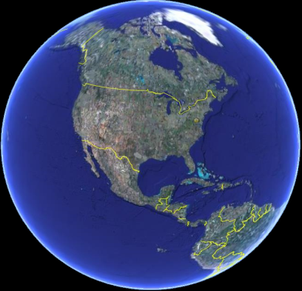

Basic Geodesy and Datums
New Orleans District
June, 2014
Mark W. Huber
US Army Corps of Engineers
Army Geospatial Center
Z
n
e
H
ф
Y
λ
X

Slide 2
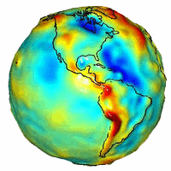
Overview
What is a Datum?
  Why is it important?
Geodesy
  Size and Shape of the Earth
Datums
  NAD 83, NAVD88, Tidal
  Converting between
Questions

Slide 3


Please Ask Questions As We Go Along
Questions?

Slide 4
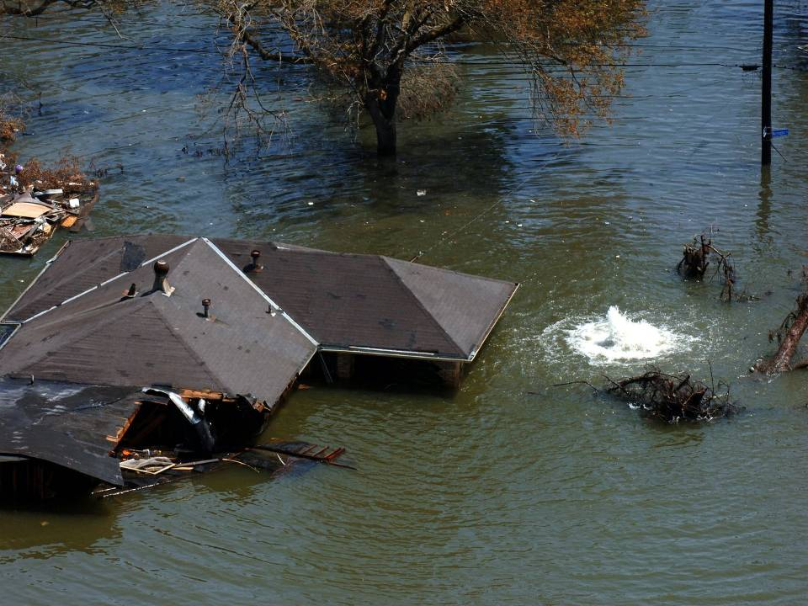
How high is the water?
a. 0.0 feet ?
LMSL (1983-2001)
b. 0.5 feet?
NAVD 88 (2004.65)
c. 7.0 feet?
Above the Slab
d. All of the Above?
d. All of the Above!
Notes:
Man has been concerned about the earth on which he lives for many centuries. During very early times this concern was limited, naturally, to the immediate vicinity of his home; later it expanded to the distance of markets or exchange places; and finally, with the development of means of transportation man became interested in his whole world. Much of this early "world interest" was evidenced by speculation concerning the size, shape, and composition of the earth.
The early Greeks, in their speculation and theorizing, ranged from the flat disc advocated by Homer to Pythagoras' spherical figure-an idea supported one hundred years later by Aristotle. Pythagoras was a mathematician and to him the most perfect figure was a sphere. He reasoned that the gods would create a perfect figure and therefore the earth was created to be spherical in shape. Anaximenes, an early Greek scientist, believed strongly that the earth was rectangular in shape.

Slide 5
“EARTH SURFACES”
Before discussing datums we need to understand various “earth surfaces”
Topographic – Actual land surface or the seafloor (bathymetric)
Geoid – Less irregular surface with the same gravity potential – approximates Mean Sea Level
Ellipsoid – Mathematical best fit to the geoid – may be either local or global
Water – local surface influenced by gravity and other factors (used to determine design elevations)
Notes:
1. Topographic surface - very irregular (like a “prune”); too complicated for calculations from measurements
2. Geoid - less irregular surface with same gravity potential (like an “onion”); many geopotential layers to choose from; layer with geopotential surface closest to MSL was chosen
3. Ellipsoid - perfectly defined smooth surface (like a “billiard ball”); best fit to the geoid (either locally or globally); easier to do calculations
4. Plane - flat surface that approximates ellipsoid over localized areas; state plane coordinate systems

Slide 6

Z
n
e
H
Basic Geodesy
ф
Y
λ
X
Merriam-Webster: a branch of applied mathematics concerned with the determination of the size and shape of the earth and the exact positions of points on its surface and with the description of variations of its gravity field
Notes:
The rotation of the Earth creates the equatorial bulge so that the equatorial diameter is 43 km larger than the pole to pole diameter. The largest local deviations in the rocky surface of the Earth are Mount Everest (8,848 m above local sea level) and the Mariana Trench (10,911 m below local sea level). Hence compared to a perfect ellipsoid, the Earth has a tolerance of about one part in about 584, or 0.17%, which is less than the 0.22% tolerance allowed in billiard balls. Because of the bulge, the feature farthest from the center of the Earth is actually Mount Chimborazo in Ecuador.

Slide 7
Z
n
e
H
Basic Geodesy
ф
Y
λ
X
Basically it is what we use to geo-reference or position our civil works projects with respect to other related projects such as SLOSH models, historical high water marks, ADCIRC models, DFIRMS, etc.

Slide 8
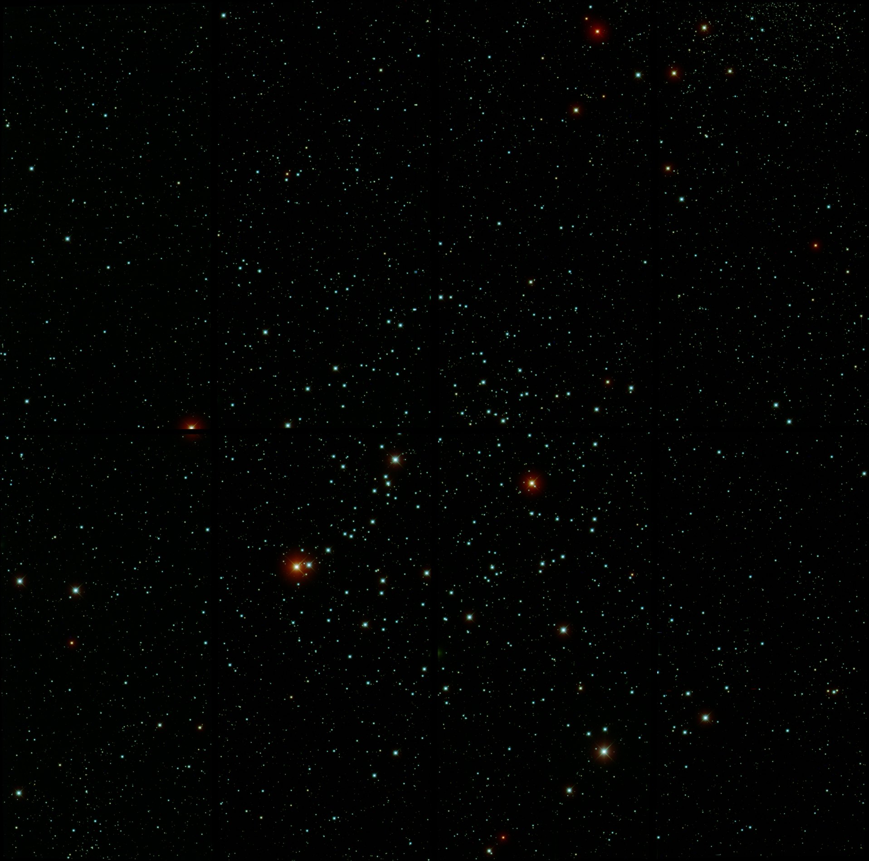
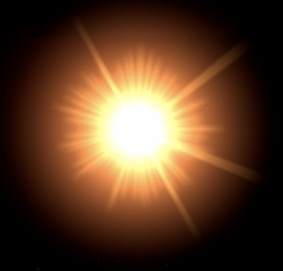
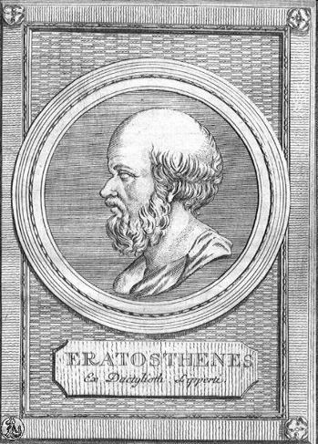
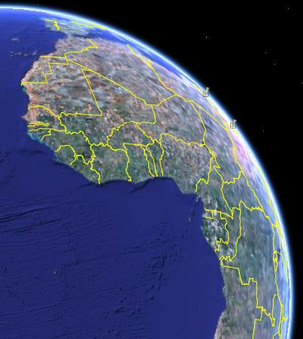
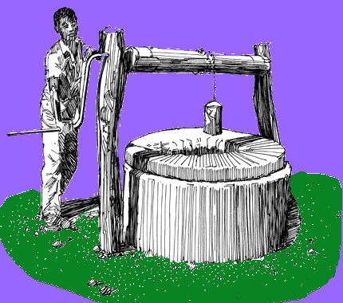

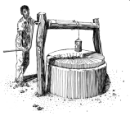

Sun not directly overhead
7 º 12’
or
1/50th
of a circle
Alexandria
500mi
Eratosthenes had observed that on the day of the summer solstice, the midday sun shone to the bottom of a well in the Ancient Egyptian city of Swenet (known in Greek as Syene).
Syene
He also knew that Alexandria and Syene were 500 miles apart
The accepted value along the equator is 24,902 miles, but, if you measure the earth through the poles the value is 24,860 miles
He was within 1% of today’s accepted value
Eratosthenes' conclusions were highly regarded at the time, and his estimate of the Earth’s size was accepted for hundreds of years afterwards.
To these observations, Eratosthenes concluded that the circumference of the earth was 50 x 500 miles, or 25000 miles.
He knew that at the same time, the sun was not directly overhead at Alexandria; instead, it cast a shadow with the vertical equal to 1/50th of a circle (7° 12').
Eratosthenes
Egypt about 240 BC
Notes:
He had observed that on the day of the summer solstice, the midday sun shone to the bottom of a well in the town of Syene (Aswan). Figure 1. At the same time, he observed the sun was not directly overhead at Alexandria; instead, it cast a shadow with the vertical equal to 1/50th of a circle (7° 12'). To these observations, Eratosthenes applied certain "known" facts (1) that on the day of the summer solstice, the midday sun was directly over the line of the summer Tropic Zone (Tropic of Cancer)-Syene was therefore concluded to be on this line; (2) the linear distance between Alexandria and Syene was 500 miles; (3) Alexandria and Syene lay on a direct northsouth line.
From these observations and "known" facts, Eratosthenes concluded that, since the angular deviation of the sun from the vertical at Alexandria was also the angle of the subtended arc, the linear distance between Alexandria and Syene was 1/50 of the circumference of the earth or 50 x 500 = 25,000 miles. A currently accepted value for the earth's circumference at the Equator is 24,901 miles, based upon the equatorial radius of the World Geodetic System (Chapter VIII). The actual unit of measure used by Eratosthenes was called the "stadia." No one knows for sure what the stadia that he used is in today's units. The measurements given above in miles were derived using one stadia equal to one-tenth statute mile.
It is remarkable that such accuracy was obtained in view of the fact that most of the "known" facts and his observations were incorrect: (1) although it is true that the sun at noon is directly overhead at the Tropic of Cancer on the day of the summer solstice, it was erroneously concluded that Syene lay on the line. Actually, Syene is 37 miles to the north; (2) the true distance between Alexandria and Syene is 453 miles and not 500; (3) Syene lies 3° 30' east of the meridian of Alexandria; (4) the difference of latitude between Alexandria and Syene is 7° 5' rather than 7° 12' as Eratosthenes had concluded.
Eratosthenes knew that on the summer solstice at local noon in the Ancient Egyptian city of Swenet (known in Greek as Syene) on the Tropic of Cancer, the sun would appear at the zenith, directly overhead. He also knew, from measurement, that in his hometown of Alexandria, the angle of elevation of the Sun would be 1/50 of a full circle (7°12') south of the zenith at the same time. Assuming that Alexandria was due north of Syene he concluded that the distance from Alexandria to Syene must be 1/50 of the total circumference of the Earth. His estimated distance between the cities was 5000 stadia (about 500 geographical miles or 950 km). He rounded the result to a final value of 700 stadia per degree, which implies a circumference of 252,000 stadia. The exact size of the stadion he used is frequently argued. The common Attic stadion was about 185 m, which would imply a circumference of 46,620 km, i.e. 16.3% too large. However, if we assume that Eratosthenes used the "Egyptian stadion"[1] of about 157.5 m, his measurement turns out to be 39,690 km, an error of less than 1%.[2]
Although Eratosthenes' method was well founded, the accuracy of his calculation was inherently limited. The accuracy of Eratosthenes' measurement would have been reduced by the fact that Syene is slightly north of the Tropic of Cancer, is not directly south of Alexandria, and the Sun appears as a disk located at a finite distance from the Earth instead of as a point source of light at an infinite distance. There are other sources of experimental error: the greatest limitation to Eratosthenes' method was that, in antiquity, overland distance measurements were not reliable, especially for travel along the non-linear Nile which was traveled primarily by boat. So the accuracy of Eratosthenes' size of the earth is surprising.
Eratosthenes' experiment was highly regarded at the time, and his estimate of the Earth’s size was accepted for hundreds of years afterwards. His method was used by Posidonius about 150 years later.

Slide 9
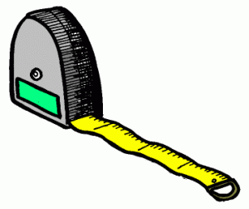
What is a Datum?
A point, line, or surface to which measurements are referenced
Local Water Surface (MSL, MLLW, flood stage, LWRP)
Ground (local topography such as street, lot, hill)
Gravity model (gravity surface)
Ellipsoid (mathematical model of the earth)
Notes:
We are bombarded with acronyms and it is getting hard to keep up. I will go over several of the most used definitions today.
Click
Who needs Geodesy and Datums – we do! They are the building blocks of our spatial reference. They tie everything together to provide a common reference.
A vertical datum is a reference (point, plane, surface, etc) to which elevations are measured from.
A vertical datum can be:
Mean Sea Level Datum of 1929 (NGVD29)
Geoid or Equipotential surface (NAVD88)
Tidal (MSL, MHW, MLLW)
International Great Lakes Datum of 1985
The zero surface to which elevations or heights are referred is called a vertical datum. Traditionally, surveyors and mapmakers have tried to simplify the task by using the average (or mean) sea level as the definition of zero elevation, because the sea surface is available worldwide. The mean sea level (MSL) is determined by continuously measuring the rise and fall of the ocean at "tide gauge stations" on seacoasts for a period of about 19 years. This averages out the highs and lows of the tides caused by the changing effects of the gravitational forces from the sun and moon which produce the tides. The mean sea level (MSL) then is defined as the zero elevation for a local or regional area. But what do you do for the Dworshak Dam or your dam? Where is the MSL in Idaho? There is no tangible surface of the ocean from which to measure height.
WE NEED SOMETHING ELSE

Slide 10
How high is the water?
0.0 feet
LMSL (1983-2001)
0.5 feet
NAVD 88 (2004.65)
7.0 feet
Above the Slab
Notes:
Man has been concerned about the earth on which he lives for many centuries. During very early times this concern was limited, naturally, to the immediate vicinity of his home; later it expanded to the distance of markets or exchange places; and finally, with the development of means of transportation man became interested in his whole world. Much of this early "world interest" was evidenced by speculation concerning the size, shape, and composition of the earth.
The early Greeks, in their speculation and theorizing, ranged from the flat disc advocated by Homer to Pythagoras' spherical figure-an idea supported one hundred years later by Aristotle. Pythagoras was a mathematician and to him the most perfect figure was a sphere. He reasoned that the gods would create a perfect figure and therefore the earth was created to be spherical in shape. Anaximenes, an early Greek scientist, believed strongly that the earth was rectangular in shape.

Slide 11


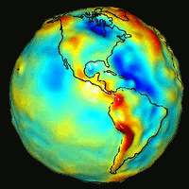
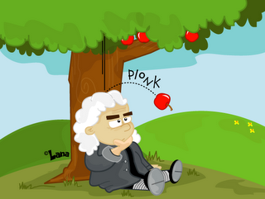
Vertical Datums
The Geoid
Gravity: Local Attraction
Unfortunately, the density of the earth’s crust is not uniformly the same. Heavy rock, such as an iron ore deposit, will have a stronger attraction than lighter materials. Therefore, the geoid (or any equipotential surface) will not be simple mathematical surfaces.
Newton’s law of universal gravitation states that the gravitational attraction between two bodies is directly proportional to their masses, and inversely proportional to the square of the distance between the bodies

Slide 12

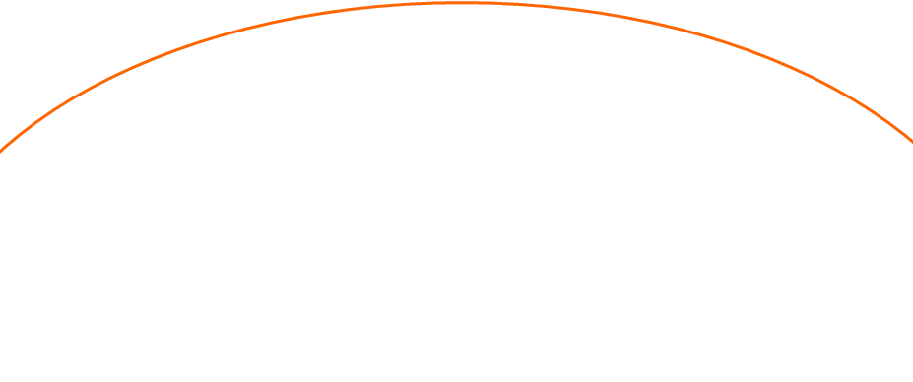
Ellipsoid vs. Geoid
Vertical Datums
Geoid Undulations
High Density
ellipsoid
Low Density
geoid
Earth’s surface

Slide 13
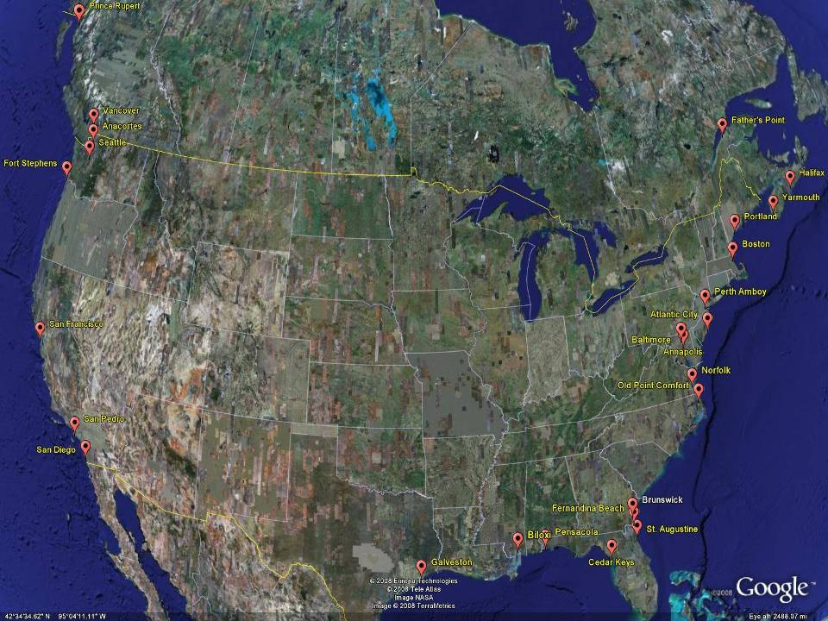

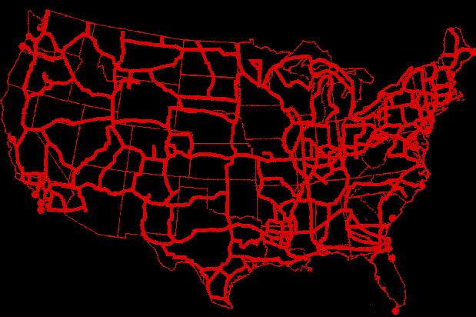
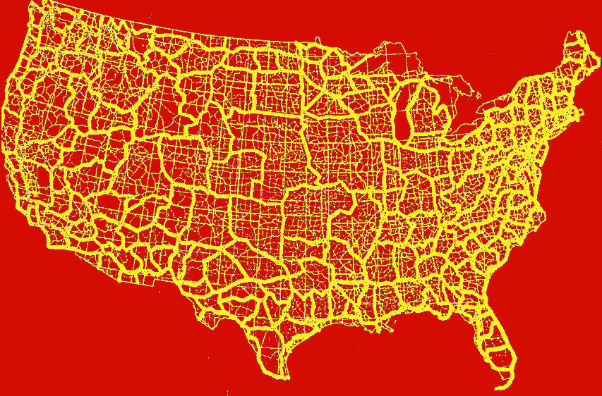
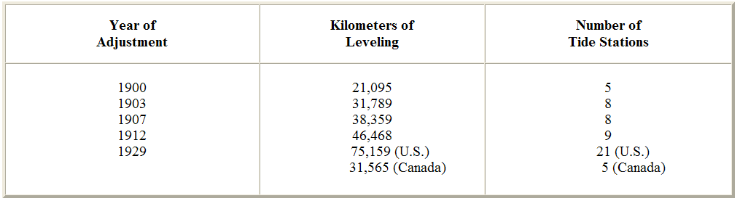
National Vertical Network
Early 1900s
NAVD88
NGVD29
SLD29
The Sea Level Datum of 1929 was referenced to 26 tide gages in the US and Canada
~100,000 km
The North American Vertical Datum of 1988 is referenced to 1 tide gage on the St. Lawrence Seaway
1,000,000+ km
The Sea Level Datum of 1929’s name was changed to the National Geodetic Vertical Datum in 1973
Notes:
It turns out that MSL is a close approximation to another surface, defined by gravity, called the geoid, which is the true zero surface for measuring elevations. Because we cannot directly see the geoid surface, we cannot actually measure the heights above or below the geoid surface. We must infer where this surface is by making gravity measurements and by modeling it mathematically. For practical purposes, we assume that at the coastline the geoid and the MSL surfaces are essentially the same. Nevertheless, as we move inland we measure heights relative to the zero height at the coast, which in effect means relative to MSL.
Leveling network in the early 1900s
Click
Table showing the progression of network density and adjustments
Click
Definition: NGVD29 – The National Geodetic Vertical Datum of 1929… (21,000+ k leveling)
The Sea Level Datum of 1929 was the vertical control datum established for vertical control surveying in the United States of America by the General Adjustment of 1929. The datum was used to measure elevation or altitude above, and depression or depth below, mean sea level (MSL).
Mean sea level was measured at 26 tide gauges: 21 in the United States and 5 in Canada. The datum was defined by the observed heights of mean sea level at the 26 tide gauges and by the set of elevations of all bench marks resulting from the adjustment. The adjustment required a total of 66,315 miles (106,724 km) of leveling with 246 closed circuits and 25 circuits at sea level.
Since the Sea Level Datum of 1929 was a hybrid model, it was not a pure model of mean sea level, the geoid, or any other equipotential surface. Therefore, it was renamed the National Geodetic Vertical Datum of 1929 (NGVD 29) in 1973.
Click
The NGVD 29 was subsequently replaced by the North American Vertical Datum of 1988 (NAVD 88) based upon the General Adjustment of the North American Datum of 1988.
NAVD88 is tied or held fixed at one bench mark (Rimouski at Father’s Point along the St. Lawrence Seaway.

Slide 14
Questions On Vertical Datums?
Name: Mark W. Huber
E-Mail: Mark.W.Huber@usace.army.mil
Organization: USACE Army Geospatial Center
Address: 3814 Big Creek Road
Morganton NC, 28655

Slide 15

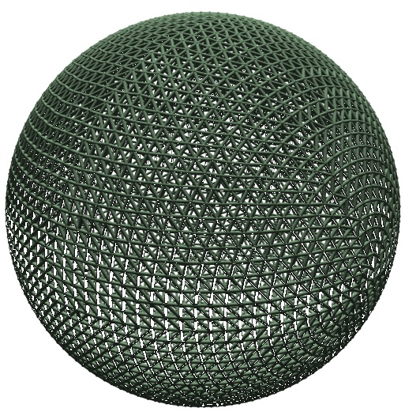
Earth
An ellipsoid of revolution is the figure which would be obtained by rotating an ellipse about its shorter axis. The GRS80 ellipsoid is used for the NAD83.
So we squash the sphere to fit better at the poles.
This creates a spheroid
Close Fit At The Equator
But The Poles Are Out
  b = 6,356,752.31414 m
  a = 6,378,137.00000 m
GRS80 fits geoid to about +/- 300’
  a= 6378137.00000 meters
  b= 6356752.31414 meters
  f= 1/(a-b)/a = 298.2572220972
NAD83 uses the
GRS80 Ellipsoid
Notes:
This shape is what we reference NAD83 and the GPS system to.
Both the horizontal and vertical coordinates originate with this surface.
The Pythagorean concept of a spherical Earth offers a simple surface which is mathematically easy to deal with. Many astronomical and navigational computations use it as a surface representing the Earth. While the sphere is a close approximation of the true figure of the Earth and satisfactory for many purposes, to the geodesists interested in the measurement of long distances—spanning continents and oceans—a more exact figure is necessary. Closer approximations range from modelling the shape of the entire Earth as an oblate spheroid or an oblate ellipsoid to the use of spherical harmonics or local approximations in terms of local reference ellipsoids. The idea of a planar or flat surface for Earth, however, is still acceptable for surveys of small areas as local topography is more important than the curvature. Plane-table surveys are made for relatively small areas and no account is taken of the curvature of the Earth. A survey of a city would likely be computed as though the Earth were a plane surface the size of the city. For such small areas, exact positions can be determined relative to each other without considering the size and shape of the total Earth.
Earth - Lumpy Bumpy rock that is difficult if not impossible to describe with an equation.
Click
Let's take a sphere and put its center at the earth's center of mass
Then resize the sphere to best fit the earth - radius of 6,378137.0 meters (later to become the semi-major axis)
This is a pretty good fit but we are out a little at the poles.
Click
Now we can squash the sphere at the poles for a better fit. This creates an oblate spheroid.
Now the diameter along the polar (semi-minor) axis is 6,356,752 meters.
We can now describe the earth's shape with an equation.
a= 637813.000007 meters
b= 6356752.31414 meters
f= 1/(a-b)/a = 298.2572220972
Click
We now have an ellipsoid - Since the Earth is in fact flattened slightly at the poles and bulges somewhat at the equator, the geometrical figure used in geodesy to most nearly approximate the shape of the Earth is an ellipsoid of revolution.
The ellipsoid of revolution is the figure which would be obtained by rotating an ellipse about its shorter axis. An ellipsoid of revolution describing the figure of the Earth is called a reference ellipsoid.
Definition:
NAD83 – The North American Datum of 1983 – the earth centered, earth fixed reference system that uses the GRS80 ellipsoid
The rotation of the Earth creates the equatorial bulge so that the equatorial diameter is 43 km larger than the pole to pole diameter.[37] The largest local deviations in the rocky surface of the Earth are Mount Everest (8,848 m above local sea level) and the Mariana Trench (10,911 m below local sea level). Hence compared to a perfect ellipsoid, the Earth has a tolerance of about one part in about 584, or 0.17%, which is less than the 0.22% tolerance allowed in billiard balls.[38] Because of the bulge, the feature farthest from the center of the Earth is actually Mount Chimborazo in Ecuador.[39]

Slide 16
Simplified Concept of WGS 84 vs. NAD 83
h₈₃
h_{xx}
Earth’s
Surface
WGS 84
Origin
2.2 meters
NAD 83
Identically shaped ellipsoids (GRS-80 vs. WGS-84)
a = 6,378,137.000 meters (semi-major axis)
1/f = 298.25722210088 (flattening)
Origin
Notes:
ITRF (International Terrestrial Reference Frame) just has an origin; take NAD83 shaped ellipsoid centered at the ITRF origin to derive ITRF97 ellipsoid heights.
Ellipsoid heights NAD83 vs. ITRF97 - Defined origins are best estimate of the center of mass; NAD83 is not geocentric. Move origin; move ellipsoid surface as illustrated.
Ellipsoid height differences reflect the non-geocentricity of NAD83.

Slide 17
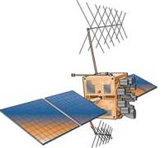

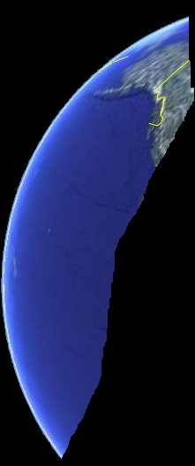
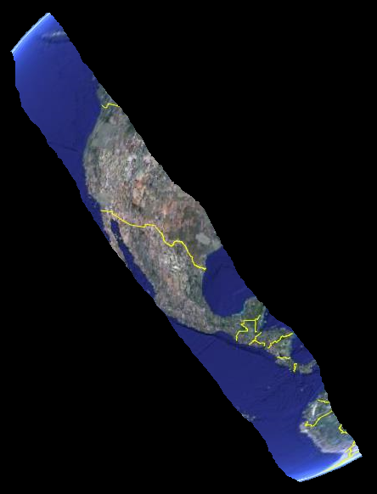

Vertical Datums for USACE Civil Works Projects
The Global Positioning System (GPS) is a Global Navigation Satellite System (GNSS) developed by the United States Department of Defense. It is the only fully functional GNSS in the world. It uses a constellation of between 24 and 32 Medium Earth Orbit (~12,000 miles) satellites that transmit precise microwave signals (19 and 24 cm), which enable GPS receivers to determine their current location, the time, and their velocity.
The first GPS satellite with the L5 signal(IIR(M)-20) was successfully launched on March 24 and its L5 payload activated on April 10.
Comprised of 3 segments
        Control: 5 Ground Stations
        Space: 24+ SVS
        User: Surveyor
The satellites use cesium or rubidium clocks to keep time. If the clock is off by just 1/1000 of a second, the measured distance will be 186 miles in error
Global Positioning System
24+ Satellites
6 Planes, 55° Rotation
4/5 Satellites /Plane
20,183 km Orbit
1 Revolution /12 Hrs
Z
n
e
H
l
Y
X

Slide 18
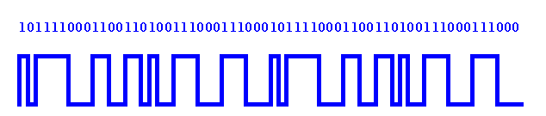
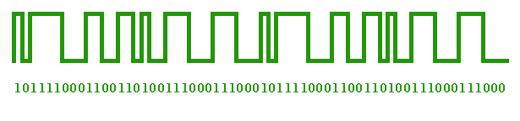


Measures Time to Compute Range
0.055
Shift in seconds
0.000
0.068
0.041
0.028
0.009
0.068 seconds x 186,000 miles/second = 12,648 miles
Satellite
Receiver

Slide 19
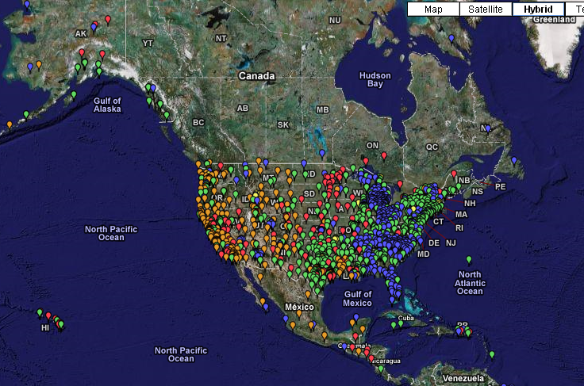
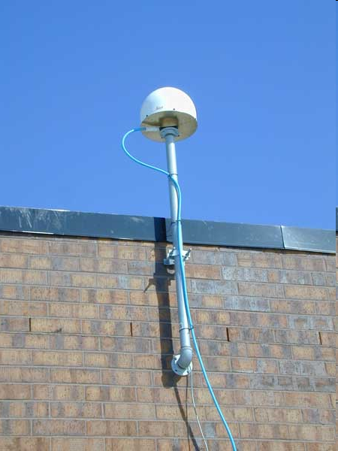
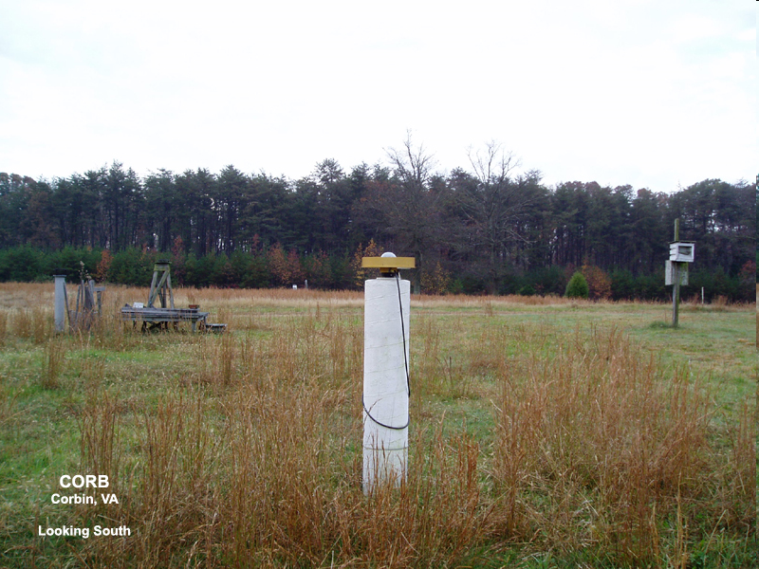
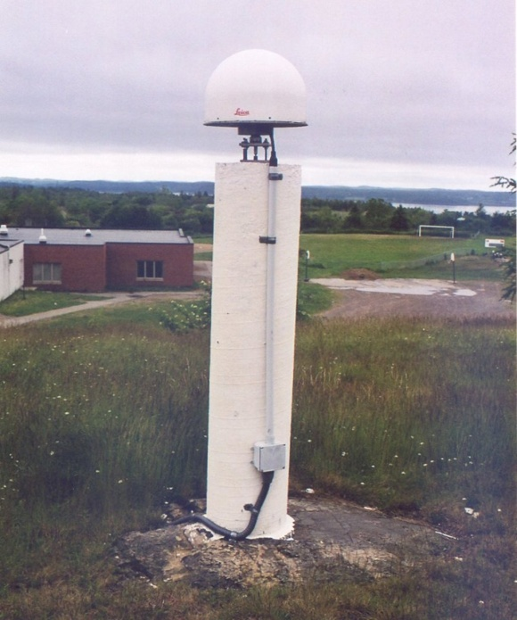
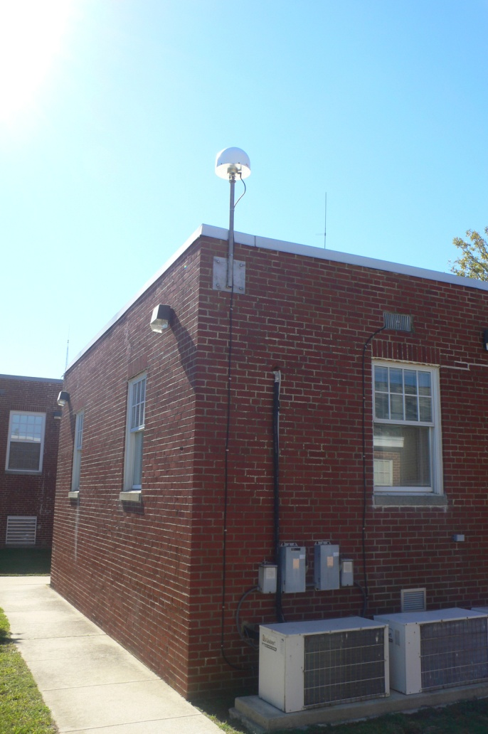
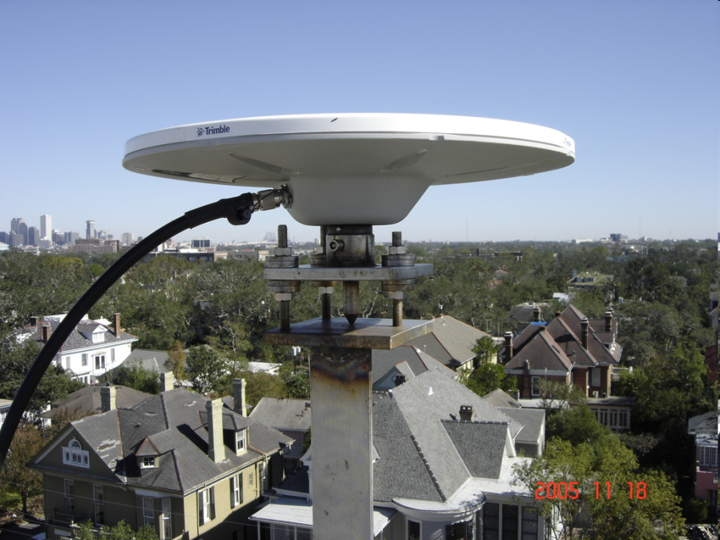

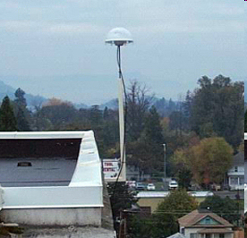
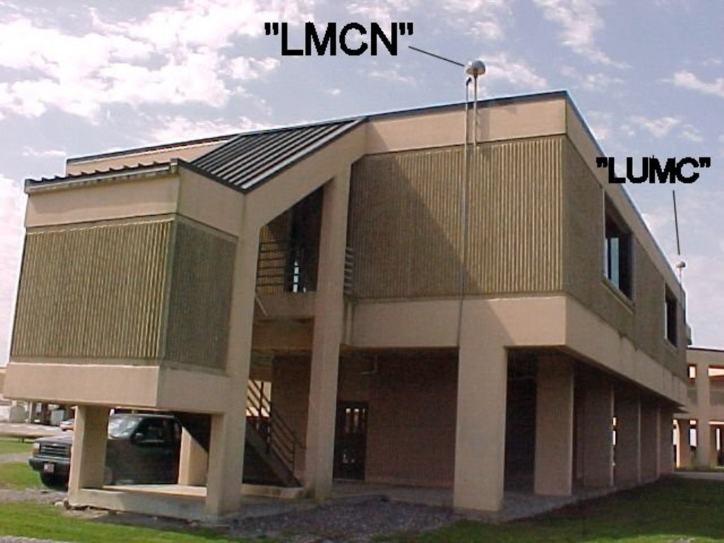
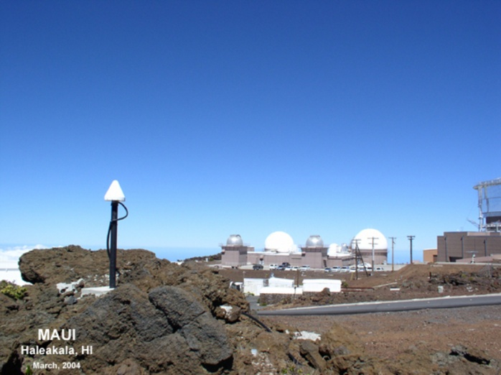
Continuously Operating Reference Stations
(CORS)

Slide 20
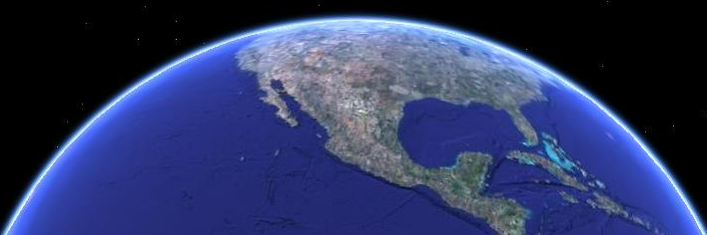
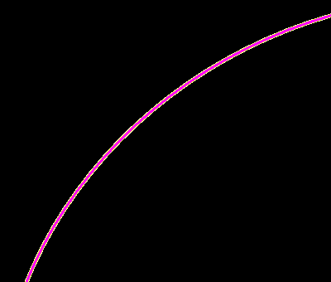
H = elevation relative to geoid (orthometric or NAVD88)
They are instead referenced to the GRS80 ellipsoid, that squashed sphere that best fits the earth and is used for NAD83
The geoid is the equipotential surface of the earth’s attraction and rotation which, on the average, coincides with mean sea level in the open ocean.
h = elevation relative to ellipsoid (GRS80)
N = separation between geoid and ellipsoid
(Geoid09)
This is what we reference our project elevations to. These are the elevations you get from the NGS datasheets and traditionally were obtained from geodetic leveling
To convert GPS derived heights to NAVD88 you must use the latest geoid model (currently Geoid09)
GPS heights are not related to either orthometric or hydraulic/tidal elevations.
Let’s take a look at the difference between NAVD88 elevations (orthometric heights) and the ellipsoid heights from GPS
h
H≈ h - N
H
Ellipsoid (GRS80)
N
Earth's Surface
Geoid

Slide 21
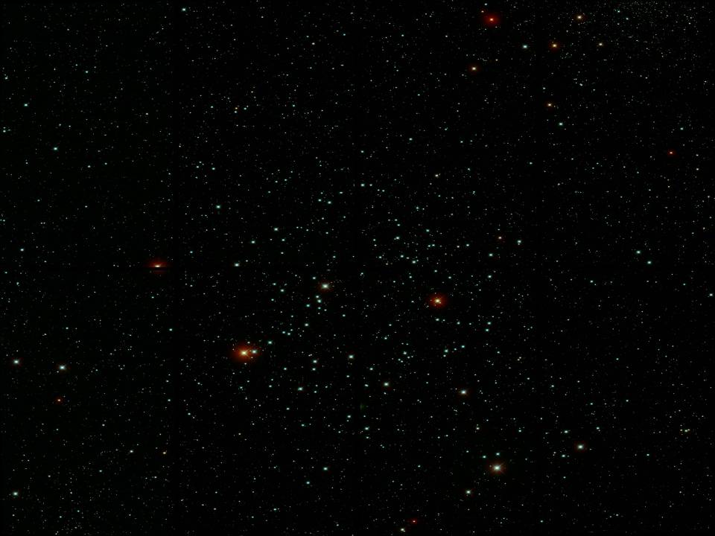
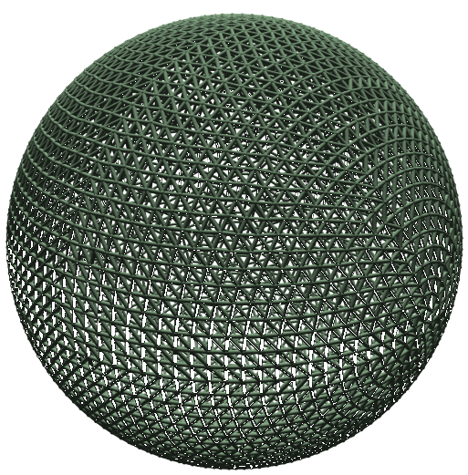
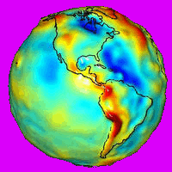
Geoid Model
GRS80
Notes:
Earth - Lumpy Bumpy rock that is difficult if not impossible to describe with an equation.
Click
Let's take a sphere and put its center at the earth's center of mass
Then resize the sphere to best fit the earth - radius of 6,378137.0 meters (later to become the semi-major axis)
This is a pretty good fit but we are out a little at the poles.
Click
Now we can squash the sphere at the poles for a better fit. This creates an oblate spheroid.
Now the diameter along the polar (semi-minor) axis is 6,356,752 meters.
We can now describe the earth's shape with an equation.
a= 637813.000007 meters
b= 6356752.31414 meters
f= 1/(a-b)/a = 298.2572220972
Click
We now have an ellipsoid - Since the Earth is in fact flattened slightly at the poles and bulges somewhat at the equator, the geometrical figure used in geodesy to most nearly approximate the shape of the Earth is an ellipsoid of revolution.
The ellipsoid of revolution is the figure which would be obtained by rotating an ellipse about its shorter axis. An ellipsoid of revolution describing the figure of the Earth is called a reference ellipsoid.
Definition:
NAD83 – The North American Datum of 1983 – the earth centered, earth fixed reference system that uses the GRS80 ellipsoid
The rotation of the Earth creates the equatorial bulge so that the equatorial diameter is 43 km larger than the pole to pole diameter.[37] The largest local deviations in the rocky surface of the Earth are Mount Everest (8,848 m above local sea level) and the Mariana Trench (10,911 m below local sea level). Hence compared to a perfect ellipsoid, the Earth has a tolerance of about one part in about 584, or 0.17%, which is less than the 0.22% tolerance allowed in billiard balls.[38] Because of the bulge, the feature farthest from the center of the Earth is actually Mount Chimborazo in Ecuador.[39]

Slide 22
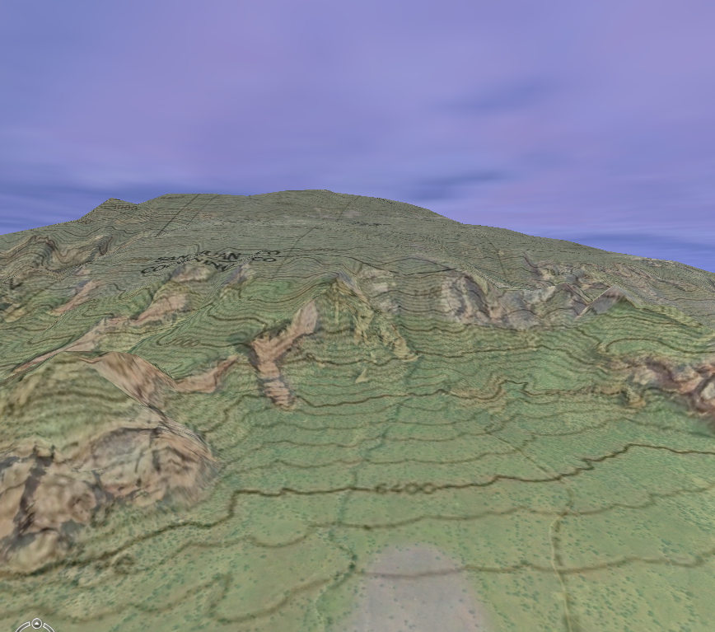
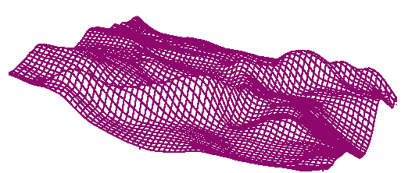
Geoid Model
GRS80
N
N
N
N
N
Geoid
(Equipotential Surface)

Slide 23
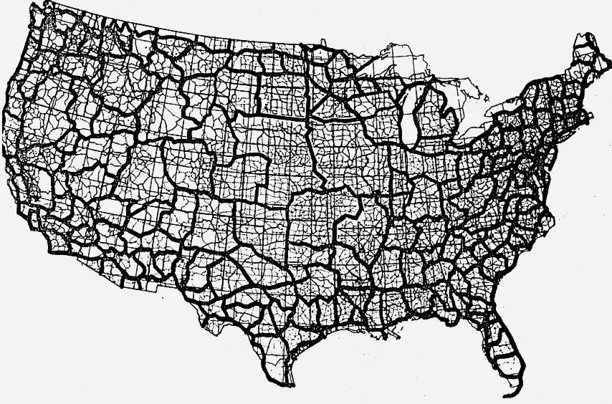

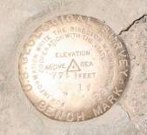
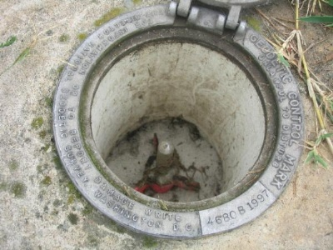
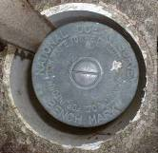
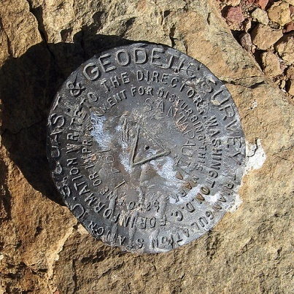
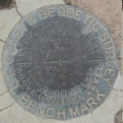
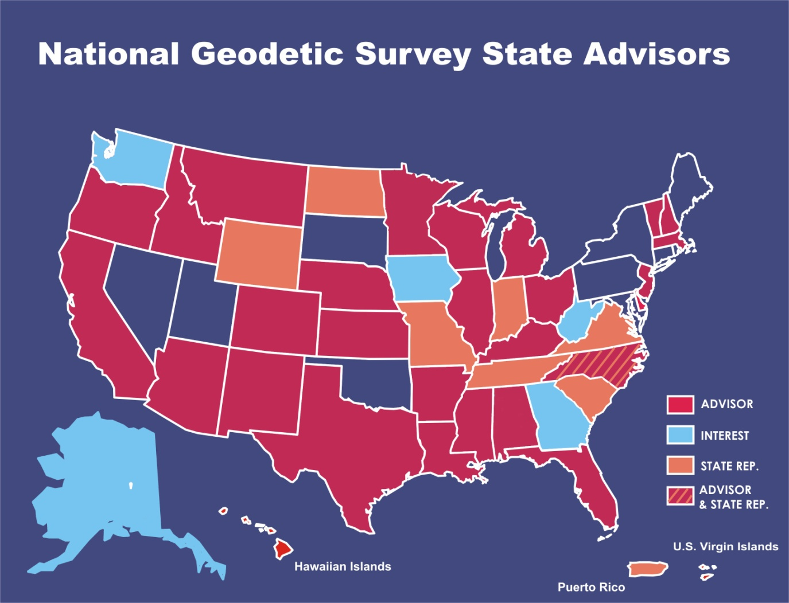
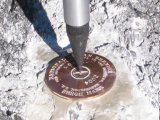
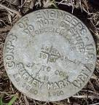
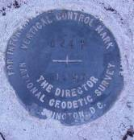
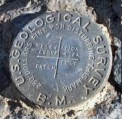


Vertical Segment of the NSRS
NOAA's National Geodetic Survey (NGS) defines and manages a national coordinate system.
This network, the National Spatial Reference System (NSRS), provides the foundation for our spatial infrastructure
NGS develops Federal standards for geodetic surveys and helps to coordinate surveying methods.
NGS State Geodetic Advisors are stationed in several states to work with local communities to expand surveying capabilities.
Notes:
This illustrates the extent of the vertical component of the NSRS at the time of the NAVD88 adjustment.
The National Spatial Reference System (NSRS) exists as a collection of discreet geodetic elements. Horizontal positions (latitude and longitude, State Plane Coordinates) referenced to the North American Datum of 1983 (NAD 83), and elevations referenced to the North American Vertical Datum of 1988 (NAVD 88) define the major components of the NGRS. Both datums are the latest definitions of systems that began with the first geodetic surveys conducted by the Survey of the Coast, founded in 1807 (later renamed the Coast Survey-1836, U. S. Coast and Geodetic Survey-1878, and National Ocean Service-1970). NGS is responsible for most of NOS' geodetic mission. These geodetic systems were developed independently with little regard to being correlated. That is, a survey monument that provided accurate horizontal coordinates was not normally connected to the vertical network, nor were vertical points related to the horizontal reference network. Today (1994), the NGRS contains information on over 300,000 horizontal control points and 600,000 vertical control points.
Click on advisor's name to bring up their presentation
It must be named ngs.ppt
.

Slide 24


Questions On The NSRS?
Name: Denis Riordan
E-Mail: Denis.Riordan@noaa.gov
Organization: National Geodetic Survey
Web: geodesy.noaa.gov

Slide 25


Tides
Tides are the rising of Earth's ocean surface caused by the gravitational forces of the Moon and the Sun acting on the oceans.
Notes:
Here you see the land is rising therefore the distance between the top of the water and the ground is getting closer, therefore overall water level is lower; again not a big deal because of the range of tide.

Slide 26





Tide Type Considerations
Statute distance between these gauges: 16.5 miles
Tide type does not necessarily transition slowly or smoothly.

Slide 27

Tide Type Considerations

Slide 28
Variable Vertical (Tidal) Datums
Higher High
Higher High
MHHW
MHW
Lower High
Observed
Water Level
MTL
LMSL
DTL
Higher Low
MLW
Lower Low
Higher Low
MLLW
Lower Low
Day 1 Day 2

Slide 29


EPOCH - Updates
Regression of the Moon’s Nodes – Variation in the path of the Moon about the Sun, such that the angle of the moon’s orbital plane with the equatorial plane varies over 18.6 yrs
Current Epoch 1983 - 2001
Red – Annual Mean Range
Green – 19-year epochs
Blue - Monthly Mean Range

Slide 30




Tidal Datums
Significance?
Subsidence and uplift both affect the relationship between the water surface and structures and hazards
This relationship must be monitored and documented

Slide 31

Neap and Spring Tides

Slide 32






Tidal Theory
Newton – it’s all about gravity (well, mostly)
new moon
Spring tides, with higher high tides and lower low tides
full moon
Spring tides, with higher high tides and lower low tides
half moon
Neap tides – muted, with higher lows and lower highs
Centrifugal force
Gravitational pull
Gravitational pull
Centrifugal force
Centrifugal force
Gravitational pull
Centrifugal force
Gravitational pull
Centrifugal force
Gravitational pull
Force due to the moon is about 2.5x greater than the force due to the sun

Slide 33


Slide 34










New Hurricane Resistant Platforms

Slide 35

RELATIVE SEA LEVEL CHANGE AT SEVERAL LOCATIONS IN THE U.S.

Slide 36





Sea Level Trend
Juneau, AK
Water depth is reduced as the land mass rises
Water Depth
Post
Glacial Rebound
Sea Level is falling relative to land at a rate of approximately 12.92 mm/yr
Or
2’+ in 50 years
Sea Level Rise

Slide 37


Mean Lower Low Water 1983-2001
Mean Lower Low Water 1960-1978
The midpoint of the 1960-1978 was 45 years ago
@ 1.7mm/yr MLLW has risen 0.25’ since
The midpoint of the 1983-2001 was 22 years ago
@ 1.7mm/yr MLLW has risen 0.12’ since
The midpoint of the 1960-1978 was 45 years ago
@ 9.24mm/yr MLLW has risen 1.36’ since
The midpoint of the 1983-2001 was 22 years ago
@ 9.24mm/yr MLLW has risen 0.67’ since
Channel Template
When sea level rises, so does MLLW and with that, all channel templates

Slide 38





Tidal Phase Differences
Flood Tide
Ebb Tide
Slope on the Water
Delta in Gage Readings
Appears Deeper
Slope on the Water
Delta in Gage Readings
Appears Shallower
Adjacent Gage
Gage at Project
Notes:
Here you see the land is rising therefore the distance between the top of the water and the ground is getting closer, therefore overall water level is lower; again not a big deal because of the range of tide.

Slide 39

Seasonal Bias
That’s almost 0.45’ in September

Slide 40
Mean Low Gulf
Established in early 1900’s
MLW at Biloxi
0.78’ below MSL or NGVD29
MVN using NGVD29 elevation from 1976

Slide 41
Mean Low Gulf
Given the fact that:
Sea level is rising
Tidal characteristics vary with location
MVN is using an epoch from 1976
MLG has absolutely nothing to do with the water surface!!! NOTHING!

Slide 42


Difference in Water Level
Pilot Town vs. Pilot Station

Slide 43


Difference in Water Level
Pilot Town vs. Pilot Station

Slide 44

Difference in Water Level
Pilot Town vs. Pilot Station

Slide 45
Questions On Tides?
Name: Michael Paul Michalski
E-Mail: Michael.michalski@noaa.gov
Title: Oceanographer / Datums Team Lead
Organization: NOAA/NOS/CO-OPS
Address: 1305 East-West Highway
N/OPS3, Sta. 7200, SSMC4
Silver Spring, MD 20910-3218
Web: www.tidesandcurrents.noaa.gov
Datums Team Email: nos.coops.datums@noaa.gov

Slide 46

Volume II of IX Volumes
Geodetic Vertical and Water Level Datums
FINDINGS & LESSONS LEARNED
Notes:
As a result of Hurricane Katrina, a study was performed to investigate the causes of critical failures in the New Orleans metropolitan area’s hurricane protection projects.
We will share the lesson’s learned and provide insight into the methodology for improved geospatial activities.

Slide 47
IPET Volume II--Geodetic Vertical and Water Level Datum Assessment
FINDINGS & LESSONS LEARNED
MSL assumed equal to NGVD29 (and NAVD88)
Inadequate benchmarks for floodwall construction
Vertical reference not indicated on documents
Vertical datum epochs not updated (geodetic & tidal)
Sea level/subsidence changes not updated
Misunderstood definitions of MSL, LMSL, NGVD, NAVD, MLLW, WGS, orthometric, hydraulic, ellipsoidal, etc.
Z
n
e
H
ф
Y
λ
X
Notes:
No consistent or common datums used across the board.
Still using MLG in violation of WRDA 92 (project authorizations need to be changed)
MLG is in reality MLLW (that was the intent) Erroneously interpreted
Project documents such as P&S did not indicate datum, epoch, or units of measure.
No evidence that subsidence was incorporated into design heights
Gage network not maintained
A 19 year tidal epoch was too large a period in areas of crustal motion (go to 5 yr)

Slide 48



Vertical Datums for USACE Civil Works Projects
ER 1110-2-8160
NSRS Regulation
“POLICIES FOR REFERENCING PROJECT ELEVATION GRADES TO NATIONWIDE VERTICAL DATUMS”
Notes:
Draft ER being developed to help get our projects tied to the NSRS.

Slide 49






Guidance Development
IPET Vol II (2007) Geodetic Vertical and Water Level Datums
EC 1110-2-6065/70 (2007)
Comprehensive Evaluation Of Project Datums - interim guidance on evaluating project datums.
ER 1110-2-8160 (2009) “Policies For Referencing Project Elevation Grades
To Nationwide Vertical Datums”
EM 1110-2-6056 (2010) “Standards And Procedures For Referencing Project Elevation Grades To Nationwide Vertical Datums”
Relate all to a Single Nationwide
Reference System (i.e. NSRS)

Slide 50




GRS80 (NAD83/GPS)
1970
2000
2020
1980
1990
2030
2010
-59.56'
The floodwall sinks due to subsidence as the sea level rises resulting in reduced level of protection
Subsidence
Level of Protection
14.00'
13.01'
12.76'
12.49'
12.22'
12.01'
11.75'
13.51'
11.53'
12.03'
12.52'
LMSL
Sea Level Rise
NAVD88
NGVD29

Slide 51

Top of Structure
(Present)
Displacement of Top of Structure
Due to Non-linear Subsidence
Coastal Storm Protection Structure
Design Height Considerations
Top of Structure
(Future)
Freeboard
(Safety Factor)
Present/Design Structure Height above
LMSL, Epoch: yyyy - yyyy
100 -Year Flood Height
(Above LMSL or Geodetic Zero
at end of Design Life)
Min. Structure Height above
LMSL @ End of Design Life
100 -Year Flood Height
(Above Present LMSL or Geodetic Zero)
100 -Year Flood Height
(Above LMSL or Geodetic Zero
at end of Design Life)
Present/Design Geodetic Elev. of
Top of Structure
100 -Year Flood Height
(Above Present LMSL or Geodetic Zero)
LMSL, Epoch: yyyy - yyyy
LMSL, Epoch: yyyy - yyyy
Minimum Geodetic Elev. of
Top of Structure @ End of Design Life
LMSL, Epoch: yyyy - yyyy
LMSL, Epoch yyyy-yyyy
Displacement of Local Mean Sea Level
Due to Eustatic Rise (assumed linear)
Present
Geodetic Elev. of LMSL,
Epoch: yyyy - yyyy
Future Geodetic Elev. of
LMSL, Epoch: yyyy - yyyy
NAVD88
Initial PBM Elev.
NAVD88
Epoch: yyyy.yy
PBM
PBM
Inter-Epoch Displacement of
Geodetic Datum “Zero”
NAVD88
Epoch: yyyy.yy
Future
PBM Elevation
Displacement of PBM
and Tide Staff Zero
Due to Non-linear Subsidence
NAVD88
Epoch: yyyy.yy
PBM
PBM
NAVD88
Epoch: yyyy.yy
Proposed Design Life of Structure

Slide 52


Project Control
Establish/recover Primary Project Control Point
Tie in LPCP via RTK (2 independent 180 epochs), levels, etc
Tie to reference gage with 3 control points
Compute and Document difference in datums
  Legacy
  NAVD88
  Local Water Surface (MLLW, Normal Pool, Flood Stage, etc.)
PI Sta 15+72.4
(LPCP)
PI Sta 25+27.8
(LPCP)
PI Sta 34+77.7
(LPCP)
COE-1
PID BJOD66
(PPCP)
COE-1
PID BJOD66
(PPCP)
PI Sta 43+27.1
(LPCP)
PI Sta 44+20.8
(LPCP)

Slide 53


Working Partnership
USACE working closely with NOAA (NGS, Office of Coast Survey, and CO-OPS)
  Source for geodetic control
  Source for gauge data
    Datums
  Assistance in Developing Guidance
  Training and Workshops
    District Datum Coordinator Training
  Tools for Connection to NSRS (OPUS-DB, VDATUM)

Slide 54
NAD 83
Current USACE Horizontal datum of reference
Mathematical basis for NAD 83 is the Geodetic Reference System of 1980 – similar to WGS 84
Network of control points in the US tied to NAD 83
Accuracy of coordinates on NAD 83 is about 1 cm
Ellipsoid heights from NAD 83 can be easily converted to elevations (NAVD 88) using accurate Geoid Models
OMB issued circular A-16: Federal agencies required to use National Spatial Reference System (NSRS) – NAD83
Federal Register Notice 57 FR 20141: Affirms “NAD 83 as the official civilian horizontal datum for U.S.”

Slide 55
NAVD 88
North American Vertical Datum of 1988 (NAVD 88) is the datum that best fits the geoid within North America
USACE CW vertical datum of reference
Has benchmarks that defines “on-the-ground” the vertical coordinate system for the US
Geoid models in the US are relative to NAVD 88 and NAD 83
Federal Register Notice 58 FR 34245: Affirms “NAVD 88 as the official civilian vertical datum for surveying and mapping activities in the United States performed or financed by the Federal Government.”

Slide 56

USACE Vertical Datums

Slide 57







The NSRS provides that common reference
Flood Insurance Rate Maps
Adjacent Projects
HEC Models
This tie is easily accomplished with GPS and OPUS-DB
THE HISTORIC OR LEGACY REFERENCE NETWORK WILL NOT CHANGE OR BE ELIMINATED. THIS PROCESS JUST RELATES YOUR NETWORK TO THE NATIONAL SPATIAL REFERENCE SYSTEM (NSRS)
LiDAR Datasets
NSRS Control
Project Primary Control
Project Local Control
Legacy Control Wil Not Change
Notes:
Why then are we so worried abut where the dam’s height is referenced?
How does the structure and the level of the reservoir relate to the floodplain downstream, FEMA’s flood maps, HEC models, homes, etc
Click
Your dam has its local control with a very high relative accuracy between the points
Click
This control is what should be tied to the NSRS. This will provide the common reference to other projects etc…
Click
Your project can then be referenced to the NSRS where its relationship to other projects, home, floodplain models, etc can be developed.
Click
FEMA flood maps, other civil works projects, hydrologic models, etc… are currently tied to the NSRS – This provides a common reference used to determine relationships

Slide 58

NAVD88 (2004.65)
Levee
14’ MSL (Design Height)
11’
BM
3.0’ MSL
4.75’ NAVD88
4.75’
3’ Measured (gauge maintenance)
Measured by local gauge
LMSL
0.5’
NAVD88
1.75’
NAVD88 (2004.65)
(changes with epochs)

Slide 59
NAVD88 (2009.55)
Levee
14’ MSL (Design Height)
11’
BM
3.0’ MSL
3.75’ NAVD88
3.75’
3’ Measured (gauge maintenance)
Measured by local gauge
LMSL
0.5’
0.75’
NAVD88
NAVD88 (2009.55)
(changes with epochs)

Slide 60
Sea Level Change
Levee
13.5’ MSL (Design Height)
11’
BM
2.5’ MSL
2.5’ Measured (gauge maintenance)
LMSL
Measured by local gauge
1.0’
NAVD88

Slide 61

Tidal datum at project
$30k to establish datum at project
$85k to install permanent gauge
$10k/yr for maintenance
Several agencies can share cost

Slide 62
Current USACE Policy
In-A-Nutshell
Projects Tied to NSRS (horizontal, orthometric, and ellipsoid height)
Projects Have Minimum 3 PBMs
Projects Tied to Reliable Gage Network
Project Documents Reflect Datum Relationships

Slide 63




Questions?
Additional Information Available at:
http://www.agc.army.mil/Missions/NationalDatumsandSubsidenceProgram.aspx
Mark.W.Huber@usace.army.mil
Sea Level Rise and Land Subsidence on a NOAA Tidal Benchmark
(set on hard ground in 1980s)

